Slide 1
Emerging Technologies for the Circular Economy
Lecture 4: Introduction to the Internet of Things (IoT)
Prof. Dr. Benjamin Leiding (Clausthal)
M.Sc. Arne Bochem (Göttingen)
M.Sc. Anant Sujatanagarjuna (Clausthal)

Slide 2
License
This work is licensed under a Creative Commons Attribution-ShareAlike 4.0 International License. To view a copy of this license, please refer to https://creativecommons.org/licenses/by-sa/4.0/ .
Updated versions of these slides will be available in our Github repository.

Slide 3
Updated BBB Links
We have to update the BBB links
Lecture: Link
Q&A: Link

Slide 4
Course Organization
Questions? Write us an email: etce-etce@tu-clausthal.de ← We will only respond to
emails written to this specific email address!

Slide 5
Examination Info
Göttingen
Oral examination
15-20min Q&A
Registration until 25.07.2022
Dates:
01.08.2022 → Afternoon
03.08.2022 → All day

Slide 6
Examination Info
Clausthal
No news yet – we will keep you posted!

Slide 7
Bonus Task
Project Registration
Bonus task:
Form groups of 2 or more people
Come up with a great idea that revolves around sustainability in general
Push the idea as far as possible throughout the semester
Record a 60s video explaining your idea and what you did throughout the semester
Selection of the 5 best ideas → bonus points for the exam (e.g., better grade – instead of 2.0 → 1.7 or something similar)
More info on points, percentages, etc. follow on the next slides (Examination)

Slide 8
Bonus Task
Project Registration
Project registration deadline: 17.05.2022
How do I register?
Form groups of 2 or more people
Come up with a great idea that revolves around sustainability in general
Write us an email (etce-etce@tu-clausthal.de) that contains:
Team name
Short description (2-5 sentences) of your idea
Team members

Slide 9
Updates – Earth Overshoot Day 2022 (Germany)
04.05.2022
Assuming that everyone on Earth lives according to our (German) standard of living → How many Earths do we need?
https://www.overshootday.org/newsroom/country-overshoot-days/

Slide 10
Back to the Lecture

Slide 11
The Nature of Technology
B. Arthur stipulates that an economy is an expression of its technologies
Thus, it can be argued that the current unsatisfying state of the Circular Economy reflects a lack of sufficiently developed technologies that express themselves within the CE.
Or, more precisely – difficulties of the stakeholders in combining the technologies that are required to enable the CE.
Arthur, Brian (2011) – The Nature of Technology: What It Is and How It Evolves.

Slide 12
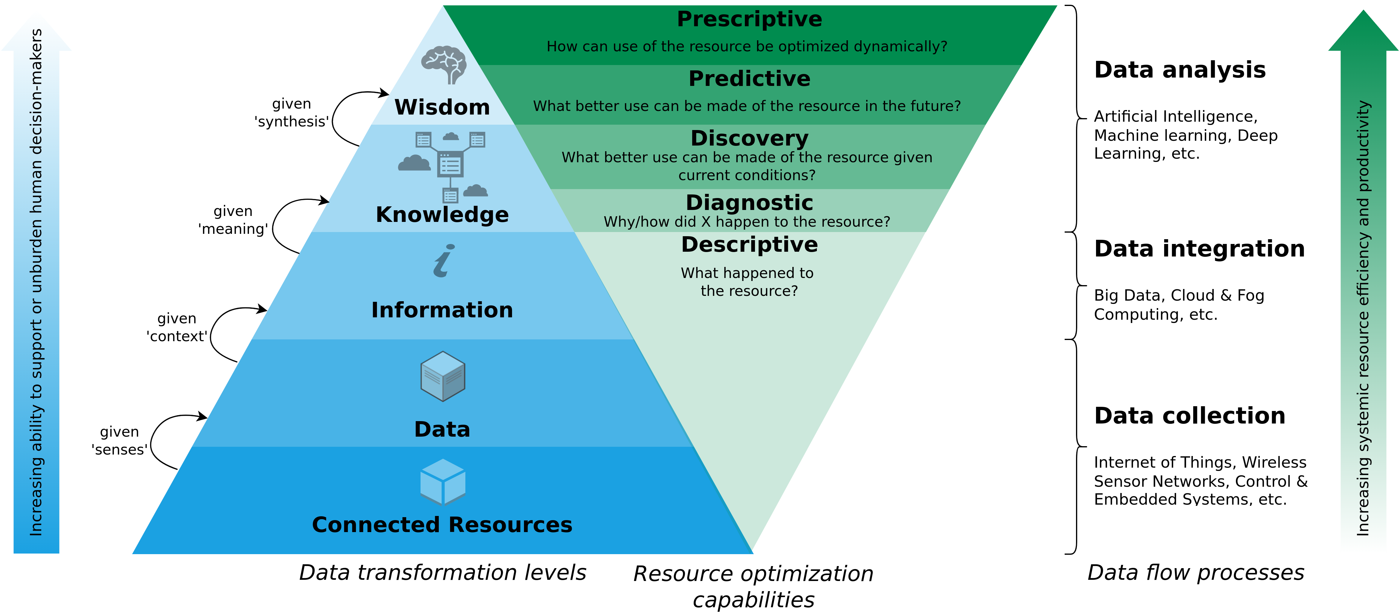
A Data-Driven Smart Circular Economy Framework
Kristoffersen et al. (2020) – The smart circular economy: A digital-enabled circular strategies framework for manufacturing companies.

Slide 13
Introduction and History

Slide 14
History
1982: Beverage dispenser with an Internet connection (Carnegie Mellon University)
1991: Vision of Ubiquitous Computing
1999: Kevin Ashton → IoT refers to the linking of clearly identifiable physical objects (things) with a virtual representation in an Internet-like structure.

Slide 15
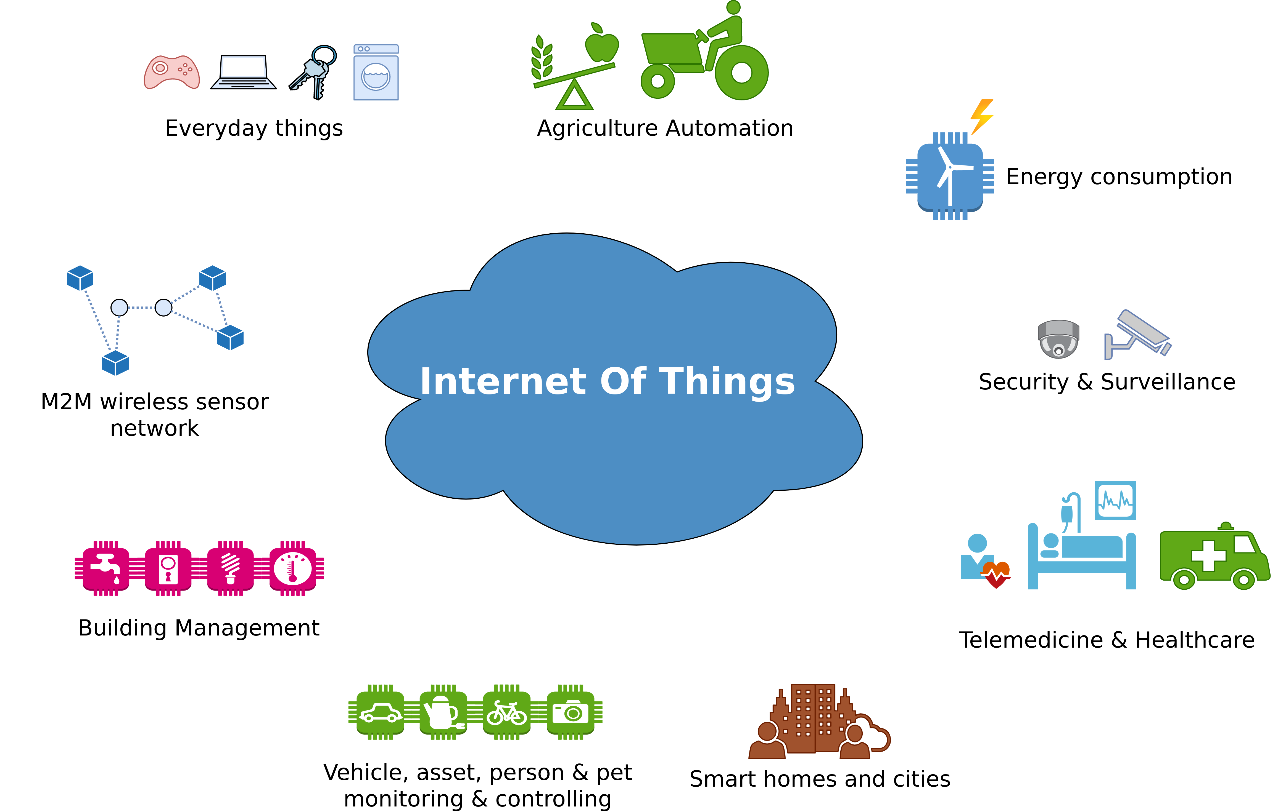
Introduction
Image adapted from: https://www.scientechworld.com/blog/telephone-network-computer-network-mobile-network-network-things-internet-things-iot/

Slide 16
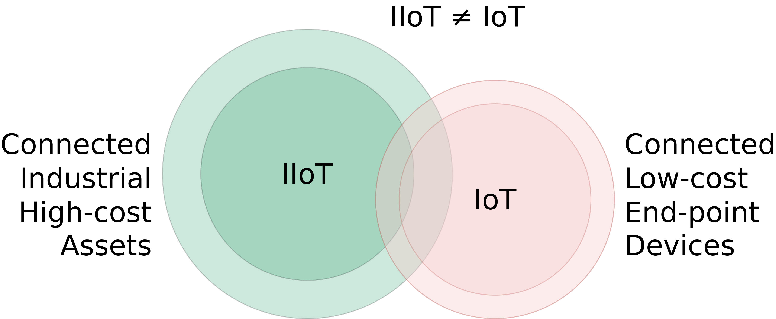
IIot vs. IoT
Image adapted from: https://web.stanford.edu/class/archive/ee/ee392b/ee392b.1186/lecture/apr3/ee392b_2018_Lecture1_Overview.pdf

Slide 17

IT and OT in IIoT
OT (Operational Technology): Hardware and software that detects or causes a change through the direct monitoring and/or control of physical devices, process and events in the enterprise.
IT (Information Technology): This is the common term for the entire spectrum of technologies for information processing, including software, hardware, communications technologies and related services.
Image and definitions adapted from: https://www.coolfiresolutions.com/wp-content/uploads/2020/09/difference-it-ot.gif andhttps://web.stanford.edu/class/archive/ee/ee392b/ee392b.1186/lecture/apr3/ee392b_2018_Lecture1_Overview.pdf respectively

Slide 18
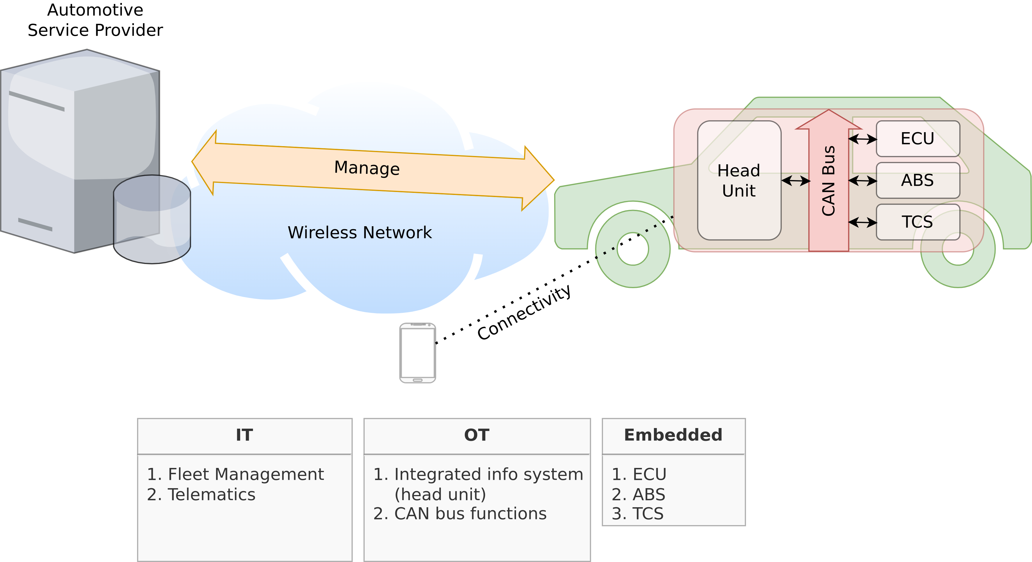
IoT Example – Connected Cars
Image adapted from https://web.stanford.edu/class/archive/ee/ee392b/ee392b.1186/lecture/apr3/ee392b_2018_Lecture1_Overview.pdf

Slide 19

IoT Example – Machine-to-Everything (M2X) Applications
Machine-to-Human (M2H)
For example → Transportation-as-a-Service

Slide 20

IoT Example – Machine-to-Everything (M2X) Applications
Machine-to-Machine (M2M)
For example → Road space negotiations

Slide 21

IoT Example – Machine-to-Everything (M2X) Applications
Machine-to-Infrastructure (M2I)
For example → Smart parking, battery charging or traffic information

Slide 22
IoT Example – Machine-to-Everything (M2X) Applications
Machine-to-Human (M2H)
+
Machine-to-Machine (M2M)
+
Machine-to-Infrastructure (M2I)
=
Machine-to-Everything (M2X)
<number>

Slide 23
IoT Example – Machine-to-Everything (M2X) Applications
M2X Economy → Is the result of business interactions, transactions and collaborations among entities of the M2X ecosystem.
Machine-to-Human (M2H)
+
Machine-to-Machine (M2M)
+
Machine-to-Infrastructure (M2I)
=
Machine-to-Everything (M2X)
<number>

Slide 24
IoT Example – Machine-to-Everything (M2X) Applications
Transforming Urban Mobility
MOBI Grand Challenge Submission Video
https://chorus.mobi

Slide 25
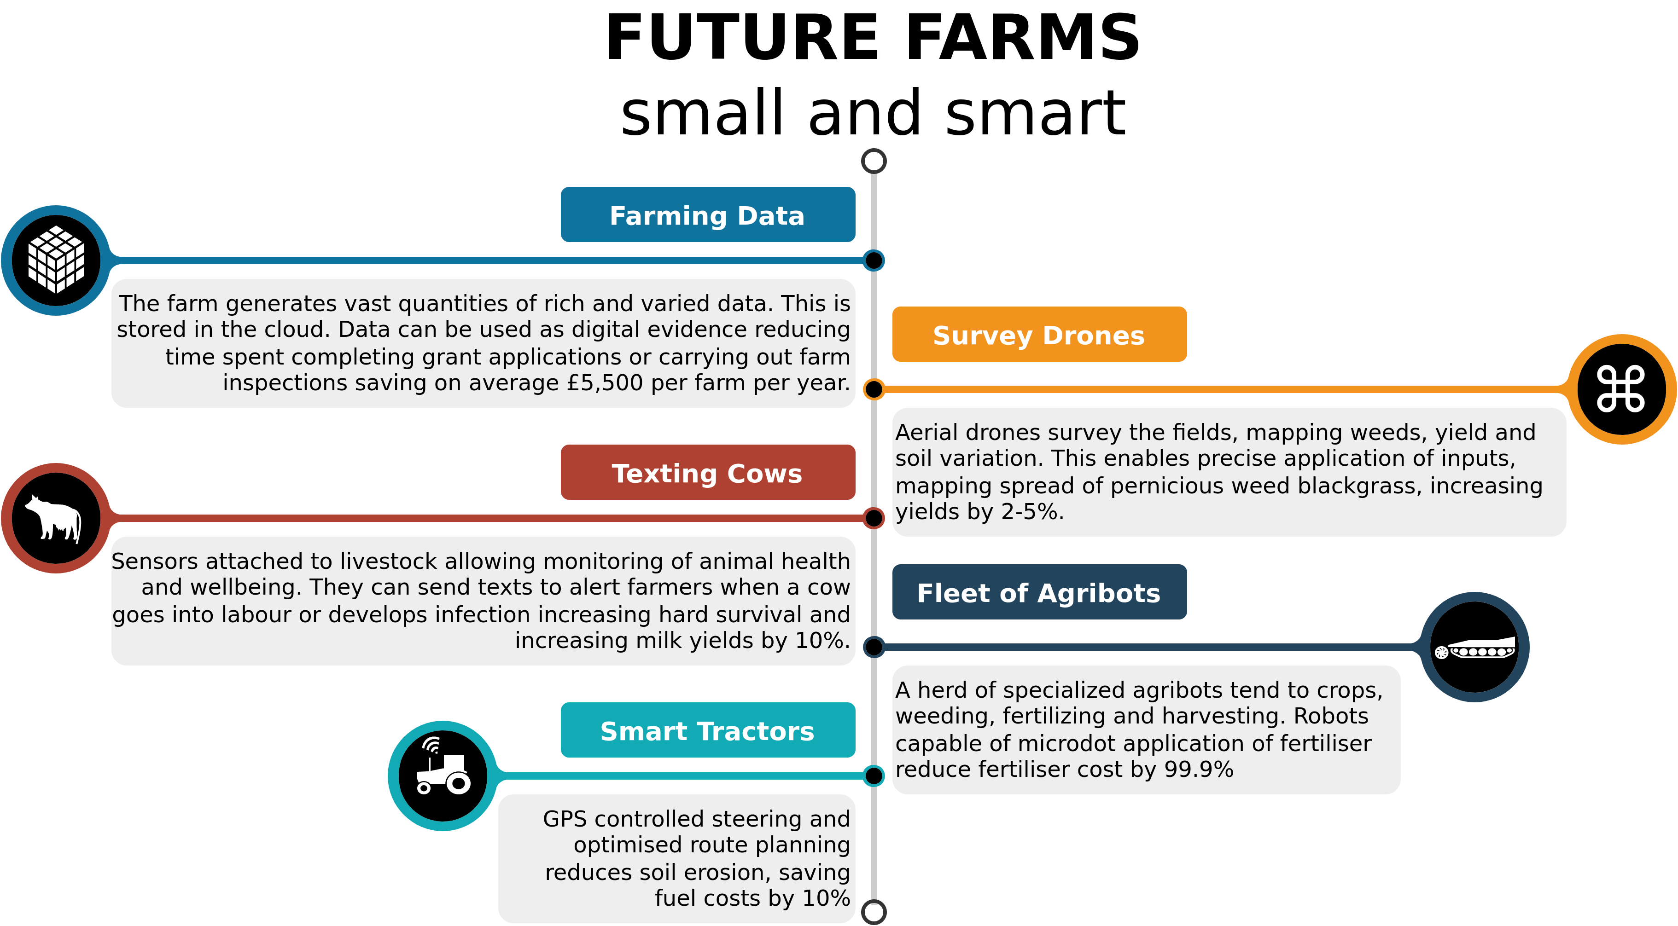
IoT Example – Agriculture
https://www.nesta.org.uk/blog/precision-agriculture-almost-20-increase-in-income-possible-from-smart-farming/

Slide 26
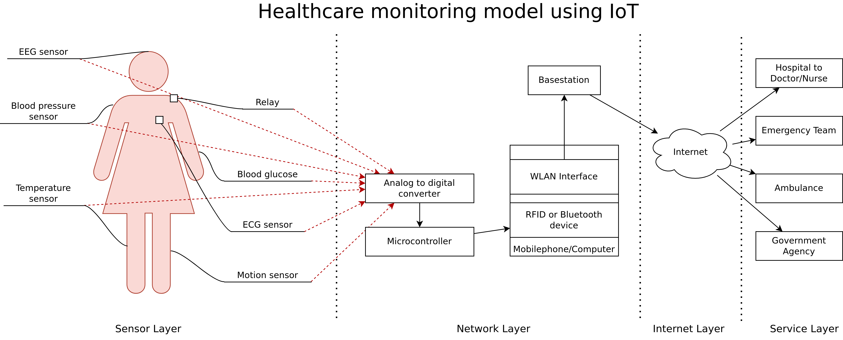
IoT Example – Healthcare
Image adapted from: Khan, Sarfraz Fayaz. "Health care monitoring system in Internet of Things (IoT) by using RFID." 2017 6th International Conference on Industrial Technology and Management (ICITM). IEEE, 2017.

Slide 27
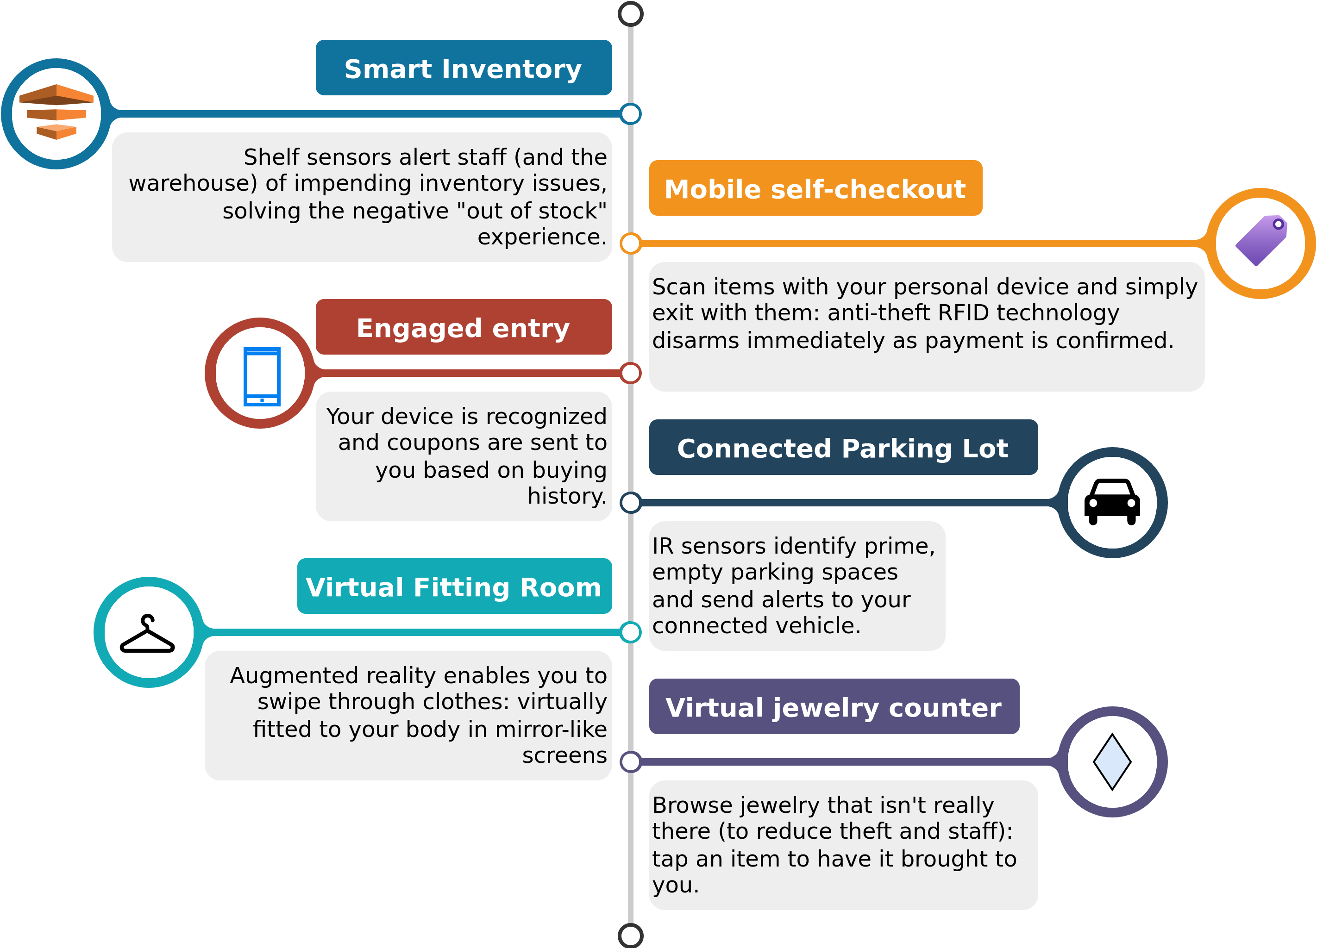
IoT Example – Smart Retail

Slide 28
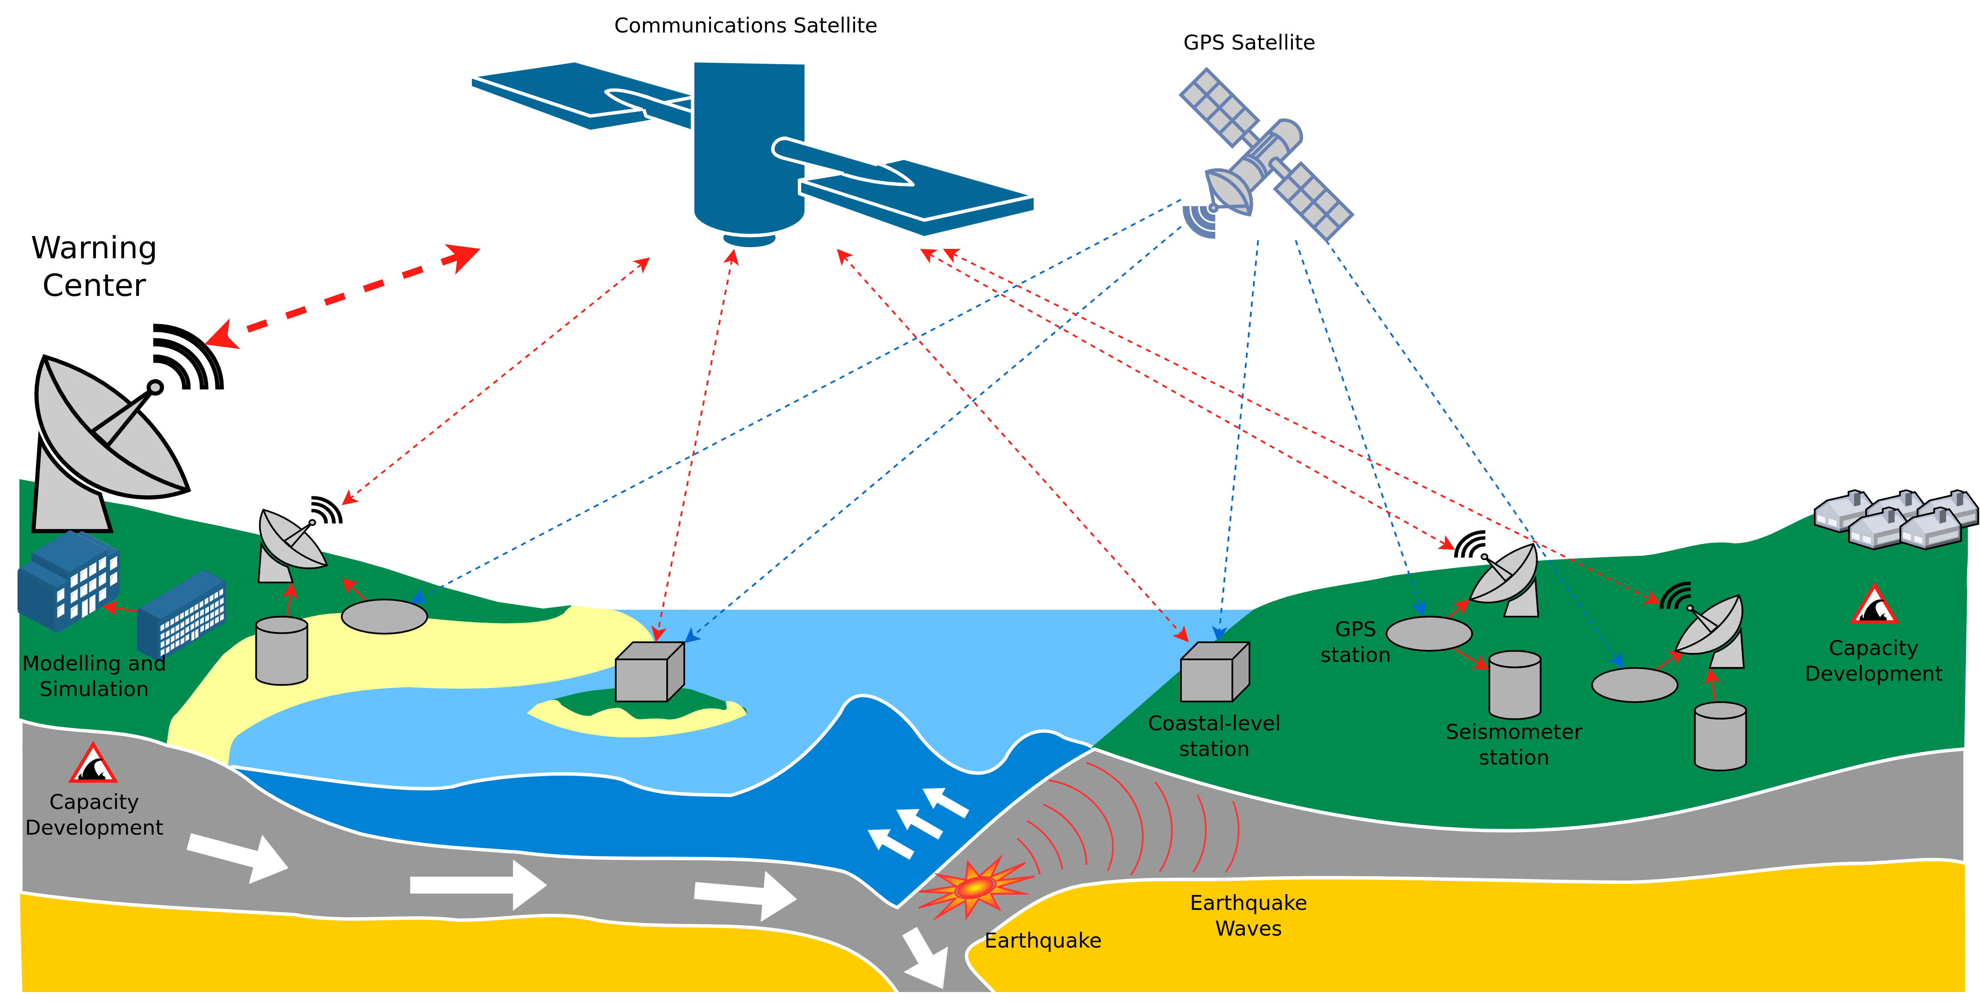
IoT Example – Tsunami Early Warning System
Image recreated from „Schematic layout of the Tsunami Early Warning System (taken from Schuh 2017a)”, https://www.researchgate.net/figure/Schematic-layout-of-the-Tsunami-Early-Warning-System-taken-from-Schuh-2017a_fig4_320655877
https://www.pnn.de/wissenschaft/bojen-ausser-kontrolle-tsunami-messbojen-vor-indonesien-sind-defekt/21910136.html

Slide 29
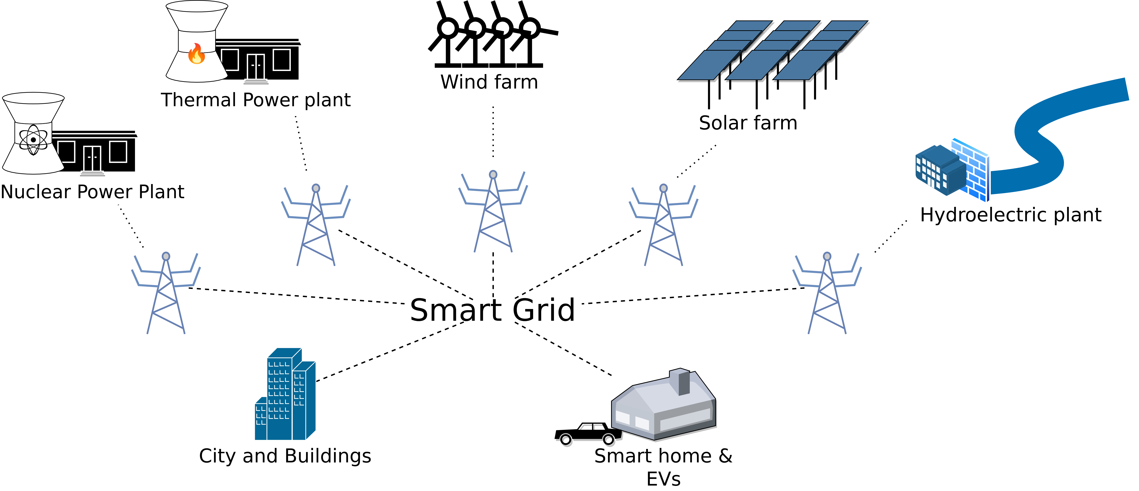
IoT Example – Smart Grids
https://blog.westmonroepartners.com

Slide 30
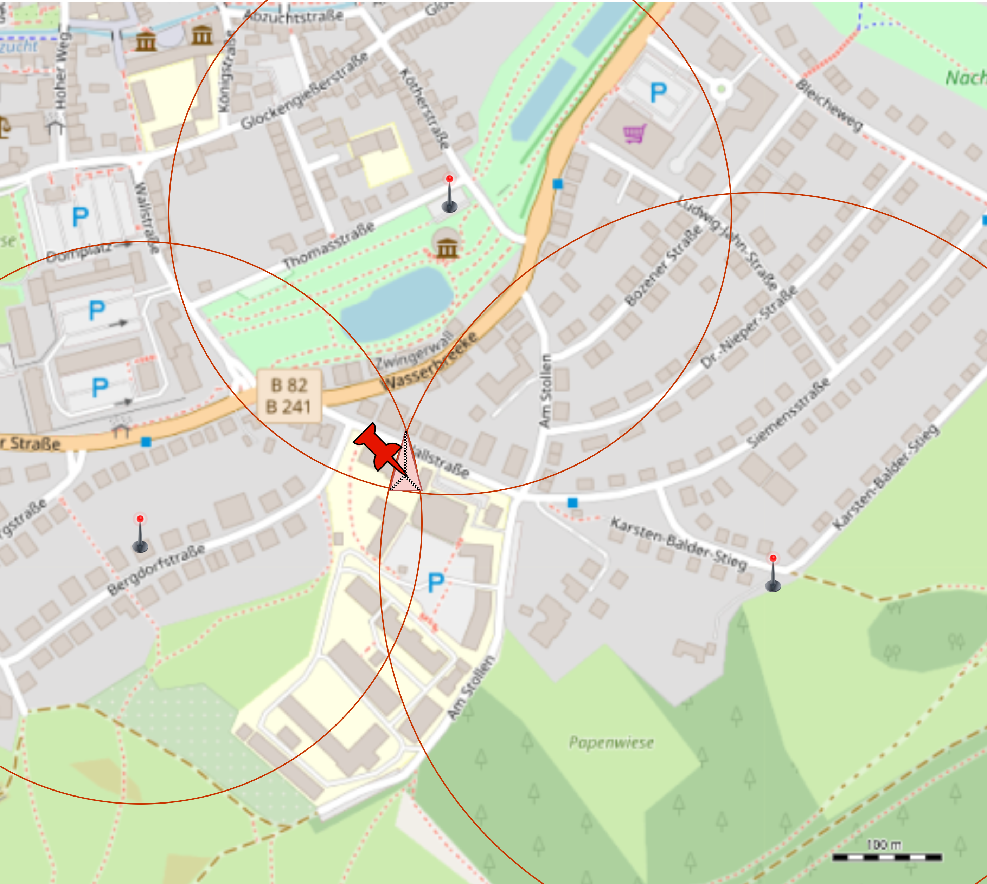
IoT Example – FOAM – Location-as-a-Service
Secure and verifiable location data through triangulation
Uses a decentralised network of LoRa sensors (more on this later)
Can also be used indoors
© OpenStreetMap contributors
https://foam.space/

Slide 31
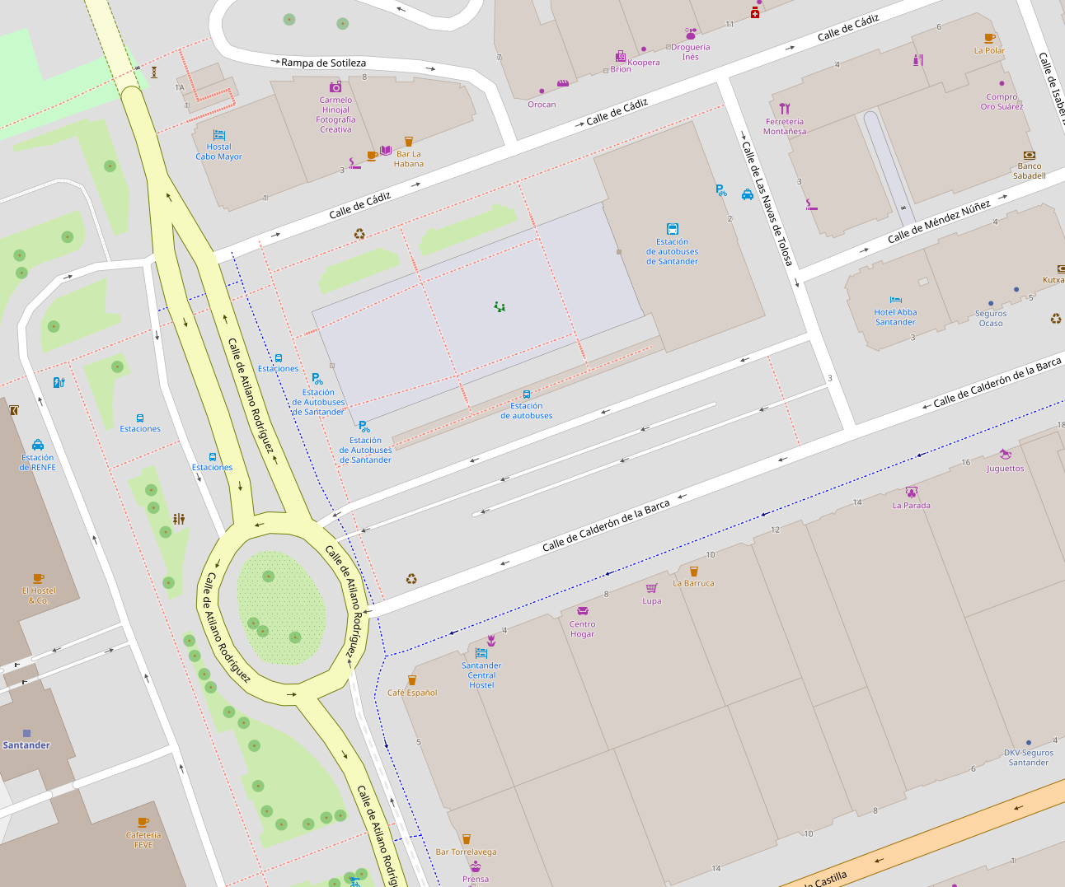

IoT Example – Smart Cities - Songdo/Santander/etc.
~12,500 sensors are placed in and around the downtown district of Santander, such as:
noise sensors
light sensors
sensors in garbage bins
These sensors measure various factors, such as
size of crowds on sidewalks 
available parking spaces 
amount of trash in containers
Vehicles such as police cars and taxis also measure pollution levels and traffic conditions.







© OpenStreetMap contributors
Example map of Santander with various sensors located around the city.
https://www.governing.com/archive/gov-santander-spain-smart-city.html

Slide 32
IoT Example – Smart Cities - Songdo/Santander/etc.
Data from sensors is analysed by banks of computers that analyse information in real-time, which city officials may use to:
adjust energy usage
optimise trash pickups for a particular week
Community-based traffic and navigation apps also help commuters to act as “sensors” themselves.
The open-sourced data also benefits citizens and tourists, who can, for example: point their phone at a bus stop to know the arrival times, or know if parking spaces are available in a general area.






© OpenStreetMap contributors
Example map of Santander with various sensors located around the city.
https://www.governing.com/archive/gov-santander-spain-smart-city.html

Slide 33
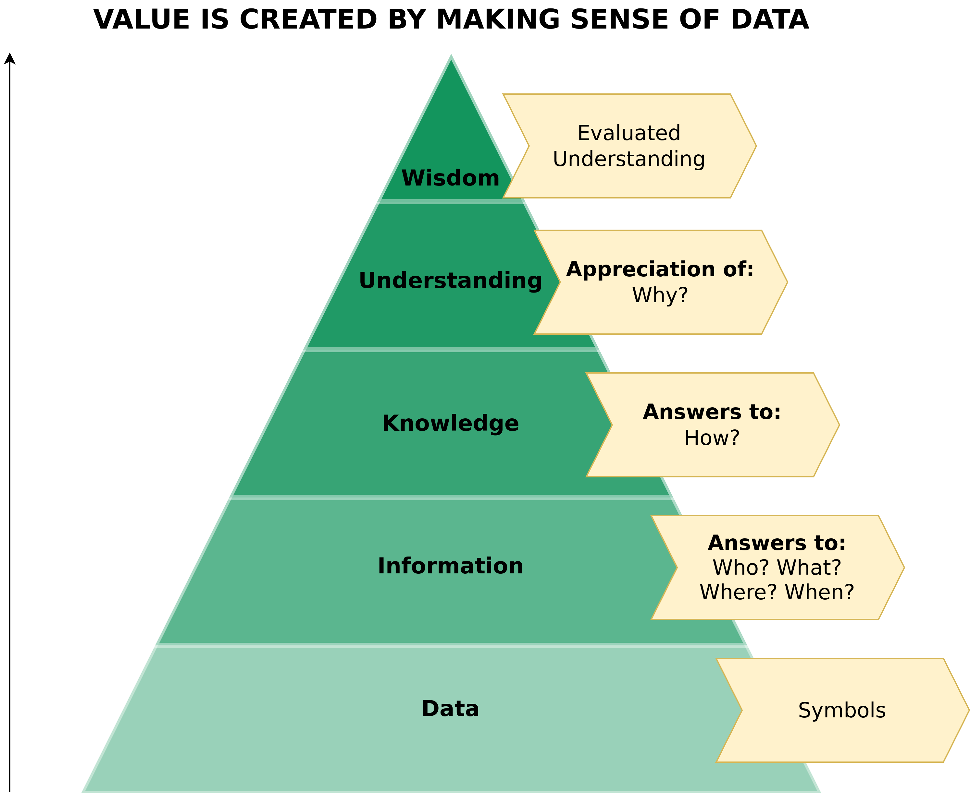
The Value of Data

Slide 34
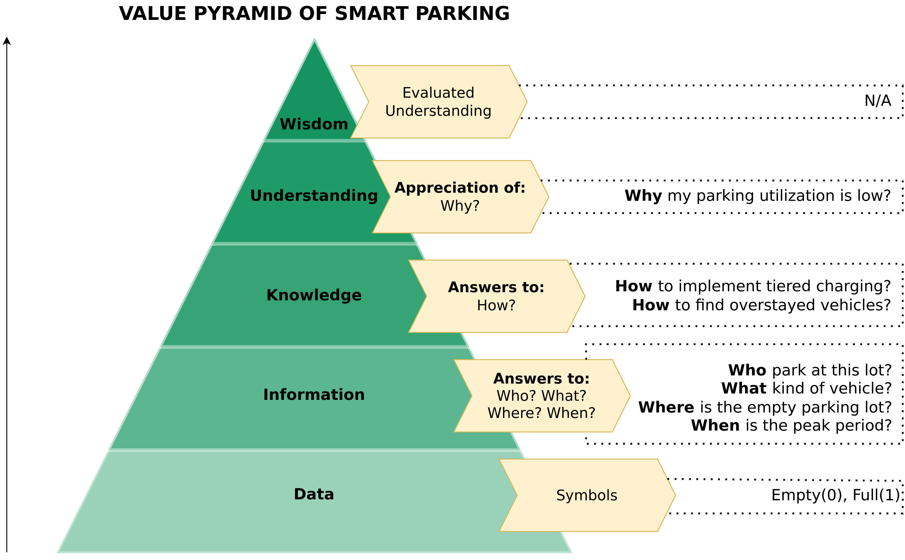
The Value of Data – Smart Parking

Slide 35
A Data-Driven Smart CE Framework
Image adapted from: Kristoffersen et al. (2020) – The smart circular economy: A digital-enabled circular strategies framework for manufacturing companies.

Slide 36
So what is the Internet of Things?

Slide 37
Internet of Things (IoT) – Definitions
Hundreds of definitions, here are a few:
Cambridge Dictionary: “Objects with computing devices in them that are able to connect to each other and exchange data using the internet.”

Slide 38
Internet of Things (IoT) – Definitions
Hundreds of definitions, here are a few:
Cambridge Dictionary: “Objects with computing devices in them that are able to connect to each other and exchange data using the internet.”

Slide 39
Internet of Things (IoT) – Definitions
The Internet of Things (IoT) is the inter-networking of physical devices, vehicles (also referred to as “connected devices” and “smart devices”) buildings, and other items embedded with electronics, software, sensors, actuators, and network connectivity which enable these objects to collect and exchange data. – Wikipedia contributors
D.R. Kiran (2019) – Production Planning and Control: A Comprehensive Approach.

Slide 40
Internet of Things (IoT) – Definitions
The Internet of Things (IoT) is the inter-networking of physical devices, vehicles (also referred to as “connected devices” and “smart devices”) buildings, and other items embedded with electronics, software, sensors, actuators, and network connectivity which enable these objects to collect and exchange data. – Wikipedia contributors
The Internet of Things (IoT) is a computing concept that describes the idea of everyday physical objects being connected to the internet and being able to identify themselves to other devices. The term is closely identified with Radio Frequency Identification (RFID) as the method of communication, although it also may include other sensor technologies, wireless technologies or QR codes. – Technopedia
D.R. Kiran (2019) – Production Planning and Control: A Comprehensive Approach.

Slide 41
Internet of Things (IoT) – Definitions
The Internet of Things (IoT) is the inter-networking of physical devices, vehicles (also referred to as “connected devices” and “smart devices”) buildings, and other items embedded with electronics, software, sensors, actuators, and network connectivity which enable these objects to collect and exchange data. – Wikipedia contributors
The Internet of Things (IoT) is a computing concept that describes the idea of everyday physical objects being connected to the internet and being able to identify themselves to other devices. The term is closely identified with Radio Frequency Identification (RFID) as the method of communication, although it also may include other sensor technologies, wireless technologies or QR codes. – Technopedia
The Internet of Things (IoT) is the inter-networking of physical devices, vehicles (also referred to as “connected devices” and “smart devices”) buildings, and other items embedded with electronics, software, sensors, actuators, and network connectivity which enable these objects to collect and exchange data. -- http://internetofthingsagenda.techtarget.com
D.R. Kiran (2019) – Production Planning and Control: A Comprehensive Approach.

Slide 42
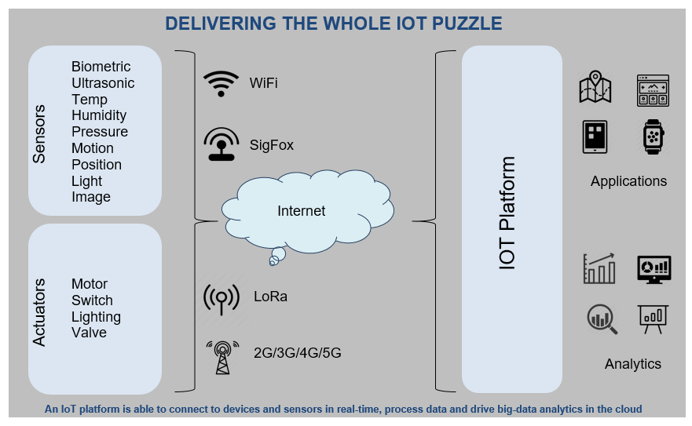
What‘s next?

Slide 43
Sensors

Slide 44
Conventional Sensors
Status values:
Deliver a defined (voltage) value once the measurement event has occurred.
Examples:
Push-button
Reed switch
Hall sensors
Light barriers
Temperature/(ultra) sound/radar sensors
Continuous values:
Provide a continuous value (e.g. voltage value) depending on the measured value
→ requires A/D converter

Slide 45
Temperature Sensors – Overview
Type | NTC Thermistors | Thermocouple Sensors | Platinum Sensors | Thermopiles | Digital Sensors
Features | Small Size High sensitivity | Extremely small Size, High temperature, Rugged | Superior long-term stability, PTC (Positive Temp. Coefficient) Linear output, Rugged | Non-contact sensor, High temperature, can take measurements from several meters away. | Ease of use, Board mounting, Small size
Range | -150°C to 300°C | -270°C to 1800°C | -200°C to 600°C | -270°C to 2000°C | -150°C to 300°C
Interchangeability rating | 5/5 | 3/5 | 5/5 | 1/5 | 3/5
Linearity rating | 1/5 | 3/5 | 5/5 | 1/5 | 5/5
Accuracy rating | 5/5 | 3/5 | 5/5 | 3/5 | 5/5
Ruggedness | 3/5 | 5/5 | 5/5 | 1/5 | 3/5
Usefulness | Dialysis, HVAC, Calorimetry, Stoves, Industrial reference | Cryogenics, Oven, Soldering Iron, Exhaust Gas detection, Independent vehicle heater | Calorimetry, Oven, Soldering Iron, Cooking Stove, Independent Vehicle Heater | Ear and Forehead thermometers | Dialysis, HVAC, Calorimetry, Industrial reference
https://www.te.com/usa-en/industries/sensor-solutions/insights/temperature-sensor-insights.html

Slide 46
Smart Sensors
Complex sensors with integrated information processing, e.g.
Programmable temperature sensor and thermostat
Magnetometer (compass)
MEMS (micro-electro-mechanical system) sensors
Accelerometer (acceleration sensor)
Gyroscope ( angular rate sensor)

Slide 47
Further Sensors
Distance sensor
Ultrasound, radar or infrared with position sensitive detector (PSD → like PIR on next slide)
(Circular) movements, velocities
PIR sensors
Person detection or face recognition
Cameras with image processing

Slide 48
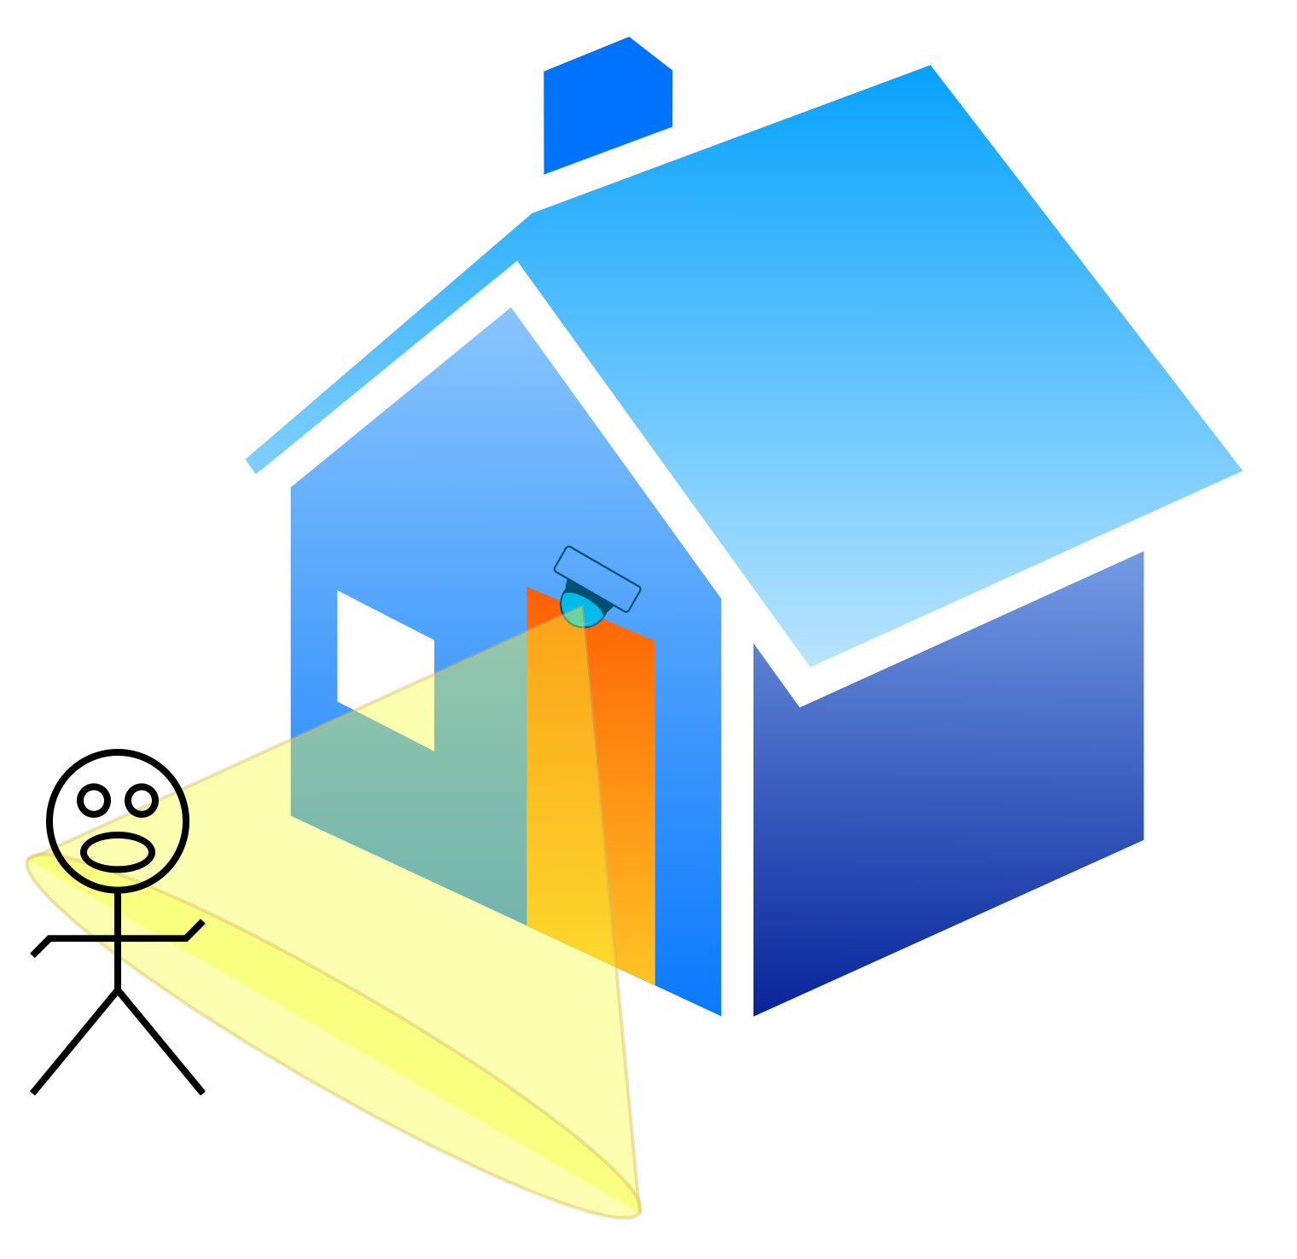
PIR-Sensor – Motion Detector
Image adapted from: http://hqdesigns.de/en/interior-guide/motion-sensor/

Slide 49
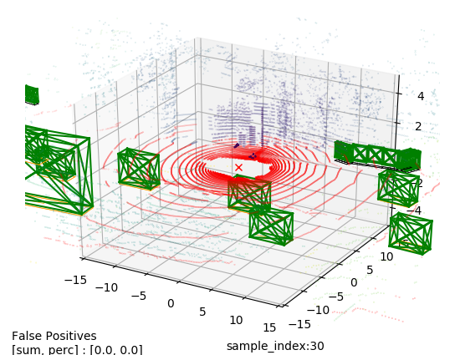
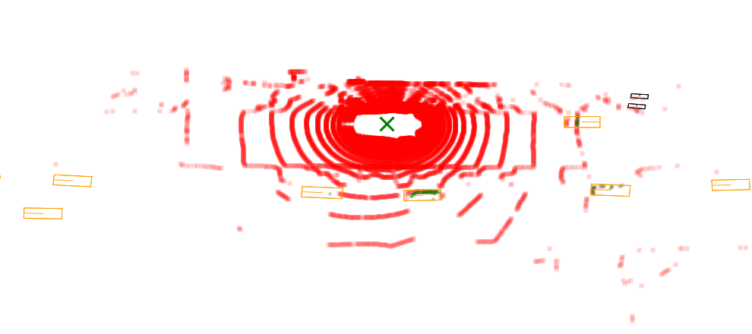
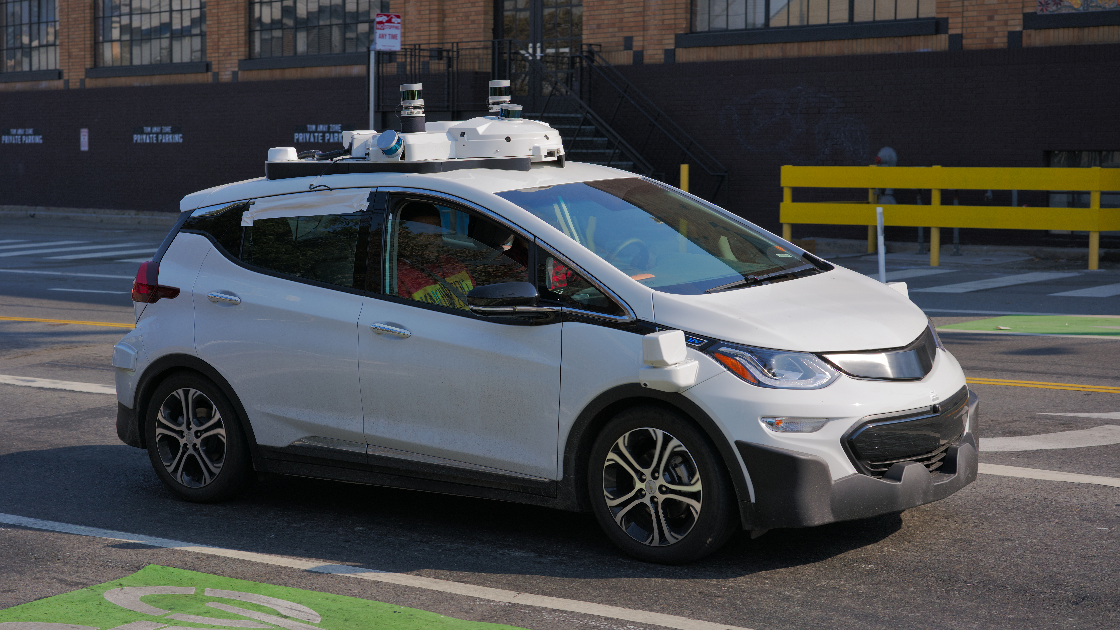
LIDAR
LIDAR → Light Detection And Ranging
Images of Lidar and Radar Point cloud data redered using the nuScenes dataset which is CC BY-NC-SA 4.0 International licensed (https://creativecommons.org/licenses/by-nc-sa/4.0/)
“Cruise Automation, Chevrolet Bolt EV third generation seen in San Francisco with 5 LIDAR sensors” by Dllu is CC BY-SA 4.0 International licensed (https://creativecommons.org/licenses/by-sa/4.0/)

Slide 50
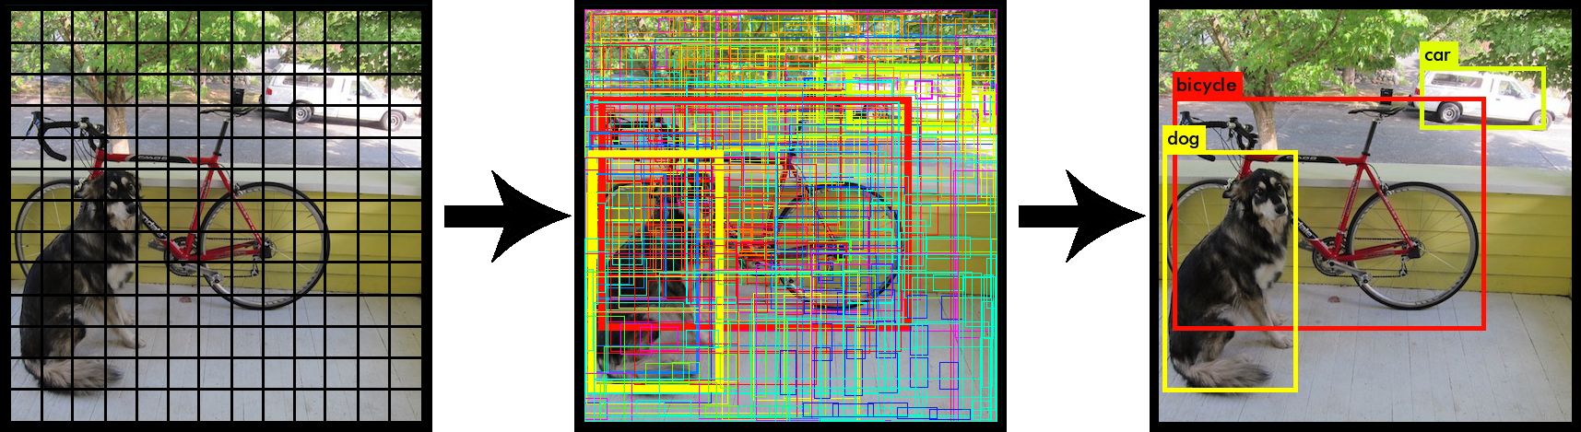
Camera Image Processing and Object Recognition
https://www.iotforall.com/objects-recognition-live-stream-yolo-model/
YOLOv3: An incremental Improvement, Redmon, Joseph and Fahradi, Ali https://arxiv.org/pdf/1804.02767.pdf

Slide 51
Sensors in Smartphones
Sensor | Function Type | Software/Hardware-based
Accelerometer | Motion sensor | Hardware-based
Gyroscope | Motion sensor | Hardware-based
Gravity | Motion sensor | Software-based
Rotation vector | Motion sensor | Software-based
Magnetic field | Position sensor | Hardware-based
Proximity | Position sensor | Hardware-based
GPS | Position sensor | Hardware-based
Orientation | Position sensor | Software-based
Light | Environmental sensor | Hardware-based
Thermometer | Environmental sensor | Hardware-based
Barometer | Environmental sensor | Hardware-based
Humidity | Environmental sensor | Hardware-based

Slide 52
Actuators
Light sources as indicators
LED
Lightbulb
LCD, LED, intelligent displays
Acoustic indicators
Bell, buzzer, piezo sound transducer
Electrical switches and drives

Slide 53
Source of Power
Solar energy
Piezo generator (conversion of mechanical energy – vibration, motion, sound)
Radio wave energy generation (RFID)
Thermal energy
Radioactive power sources
Direct connection to any power supply/grid
etc.

Slide 54
Energy Consumption
Depends on:
Computing power
Active sensors
Frequency of data collection (samples per time unit)
Communication method
Communication frequency
Other energy losses (cold/heat, inefficiency of energy supply, etc.)
Actuators, LEDs, displays, etc.

Slide 55
Energy Consumption – Example
TI SensorTag C2650 (Bluetooth SensorTag IoT-Kit):
Standby: 0.24 mA
Switched on, but all sensors off: 0.33 mA
All sensors switched on (100ms/sample) and data transmission via BLE: 5.5 mA
Temperature sensor: 0.84 mA
Light sensor: 0.56mA
Accelerometer and gyroscope: 4.68 mA
Barometer: 0.5 mA
⇒ CR2032 battery (240 mAh) → Maximum runtime of 44h.

Slide 56
Energy Consumption – Example
TI SensorTag C2650 (Bluetooth SensorTag IoT-Kit):
Standby: 0.24 mA
Switched on, but all sensors off: 0.33 mA
All sensors switched on (100ms/sample) and data transmission via BLE: 5.5 mA
Temperature sensor: 0.84 mA
Light sensor: 0.56mA
Accelerometer and gyroscope: 4.68 mA
Barometer: 0.5 mA
⇒ CR2032 battery (240 mAh) → Maximum runtime of 44h.

Slide 57
Energy Storage
Does a battery fit into the system?
What is the capacity of the battery?
Can a battery provide sufficient voltage and current?
Can the battery be replaced?
Battery weight
Battery charging frequency
Is the battery exposed to temperature fluctuations?
Deep discharge?
Type of battery (Li-ion, lead, NiCd, etc.)

Slide 58
IoT Devices

Slide 59
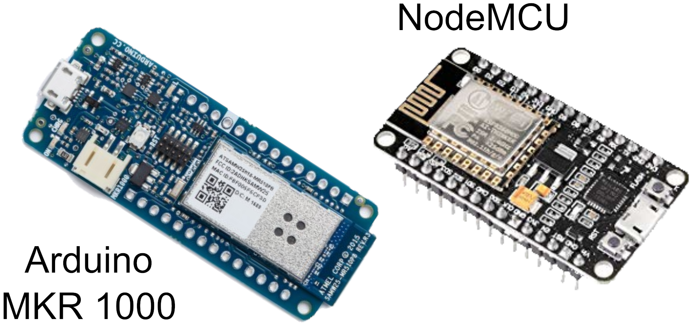
IoT Devices – Development (Low power WiFi)

Slide 60
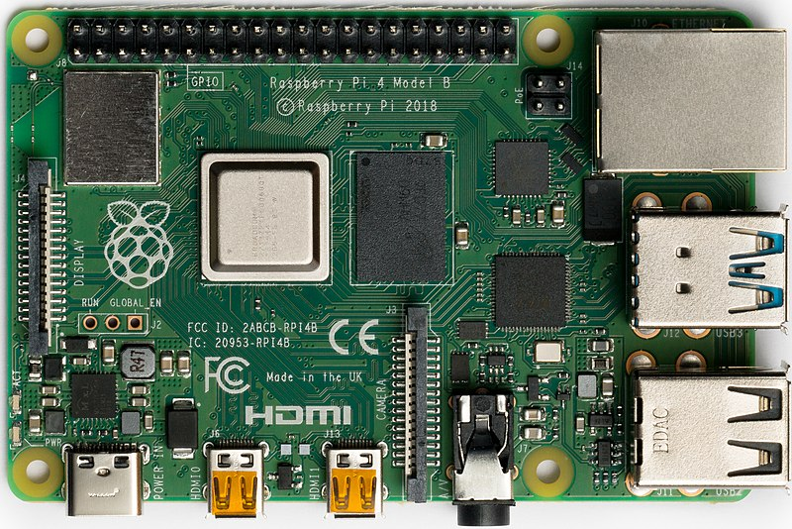
IoT Devices – Development (Higher powered)
Raspberry Pi

Slide 61
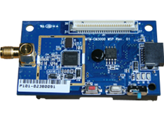
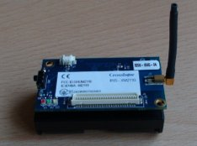
IoT Devices – Development (WSN)
Wireless Sensor Networks
Low powered devices (8bit microcontrollers)
Some common architecture
TelosB, IRIS, MicaZ, Mica2
Standardized connectors for sensor boards (51-pin Hirose)
Low power wireless standards (ZigBee, IEEE 802.15.4, LoRa)
TelosB based
IRIS

Slide 62
IoT Devices – Consumer
Smart home devices
Locks
Lights
Watering plants
Smart anything-you-can-think-of

Slide 63
IoT Devices – Industrial
Sensing state of machinery
Irrigation
Environmental monitoring
Smart grid (metering, distribution)

Slide 64
Protection Against External Forces – Ingress Protection (IP) Codes
IP Codes: Degree of protection provided by mechanical casings and electrical enclosures against intrusion, dust, accidental contact, and water.
1st Digit | Protection From Dust
0 | Non-protected
1 | Protected against solid objects greater than 50mm
2 | Protected against solid objects greater than 12mm
3 | Protected against solid objects greater than 2.5mm
4 | Protected against solid objects greater than 1.0mm
5 | Dust-protected
6 | Dust-tight
2nd Digit | Protection From Moisture
0 | Non-protected
1 | Protected against dripping water
2 | Protected against dripping water when tiled up to 15°
3 | Protected against spraying water
4 | Protected against splashing water
5 | Protected against water jets
6 | Protected against heavy waves
7 | Protected against the effects of immersion
8 | Protected against submersion

Slide 65
Exercise E03

Slide 66
E03 – IoT Sensing
Imagine a smart electric vehicle (EV) charging station that is connected to a solar panel. The goal of the smart charging station is to serve as many EVs with as much solar energy as possible. To do so, the smart charging station is interested in weather information (e.g., temperature, precipitation, cloudiness) from different sources in different locations. Bad (rainy, cloudy) indicates a lower output from the solar panel and thus less energy to charge EVs. However, lots of sun and a blue sky increase the solar panel output which allows the smart charging station to sell more energy.

Slide 67
Questions?

Slide 68
Further Resources
Dimitrios Serpanos und Marilyn Claire Wolf. Internet-of-Things (IoT) Systems Architectures, Algorithms, Methodologies (2018).
Perry Lea. Internet of Things for Architects: Architecting IoT solutions by implementing sensors, communication infrastructure, edge computing, analytics, and security (2018).

